Slide 1
Prototyping and Emulation Studies of Large-Scale 5G Wireless Systems
Team 35:
Andrew Whitehead, Dazhawn Davis, Ousmane Ntutume, Nolan Cardona, Rohan Willis
Website: https://sdmay20-35.sd.ece.iastate.edu/
Advisor/Client: Hongwei Zhang, Mattias

Slide 2
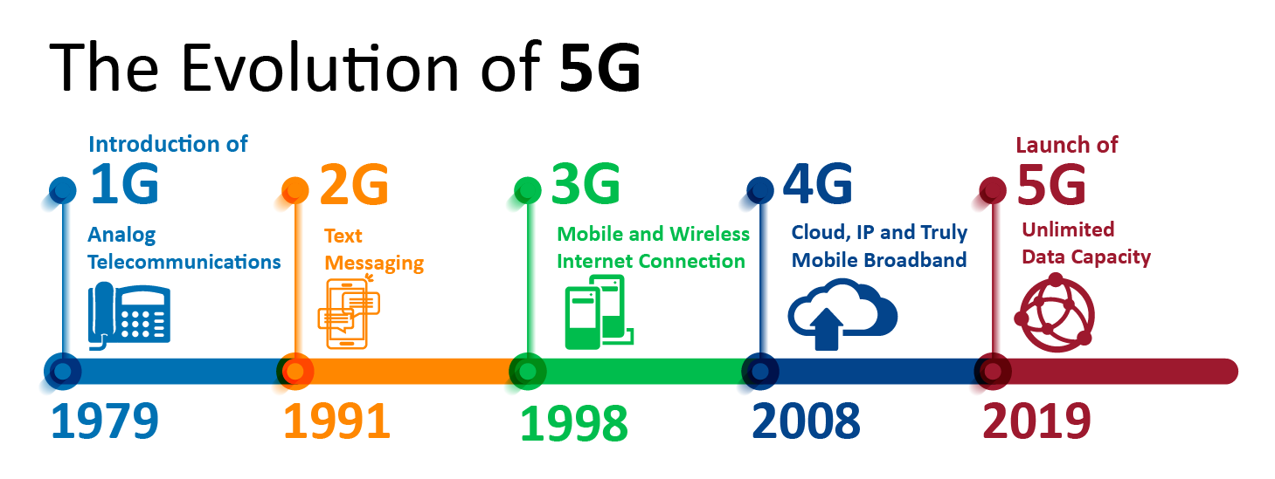
What is 5G
5G is the next generation of mobile broadband that will eventually replace, or at least augment, your 4G LTE connection. With 5G, you’ll see exponentially faster download and upload speeds. Latency, or the time it takes devices to communicate with the wireless networks, will also drastically decrease.
Offer significantly faster data speeds.

Slide 3
Importance/Impact of 5G Systems
It has the potential to transform the lives of people around the world.
Common uses
Autonomous vehicles
Cable Streaming
Remote device control
Life Changing Applications
Public safety and infrastructure
Health care

Slide 4
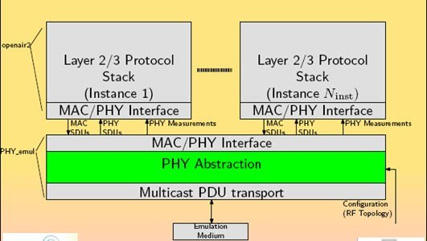
Specific Layers of 5G

Slide 5
PHY Abstraction Layer
Benefits
Lower computational complexity
Lower simulation time
Relevant Functionalities:
Channel modeling
Interference modeling:
Radio modeling:

Slide 6
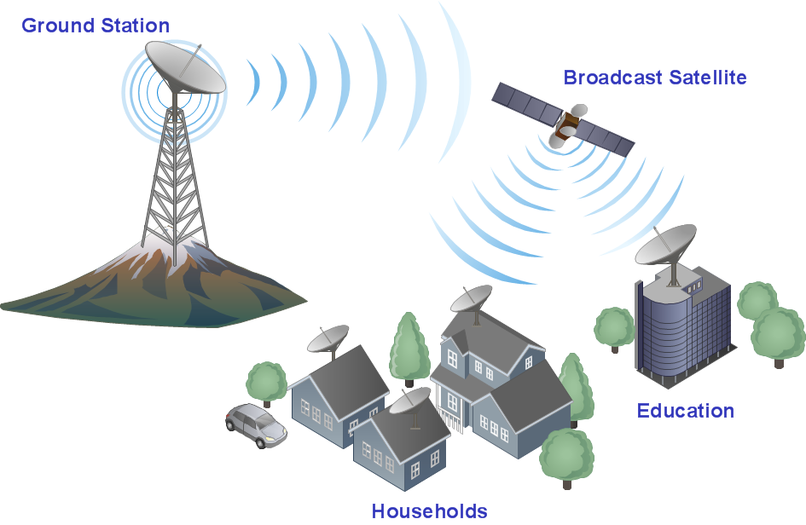
Project Overview
OpenAirinterface(OAI) provides open-source (software and hardware) wireless technology platforms
We will implement Physical Abstraction layer into new branch
Test Device to Device connection after physical abstraction layer has been implemented

Slide 7
Assumptions and Limitations
Limitations
Download correct ISO image and Kernel to support needed capabilities
Ubuntu version 14.04
Utilize the most recent version of the 5G code which includes Device to Device Communication ability
Assumptions
Physical Abstraction layers must allow for simultaneous simulations
Minimal code will be added to the existing code revision
All Code that will be implemented must documented appropriately

Slide 8
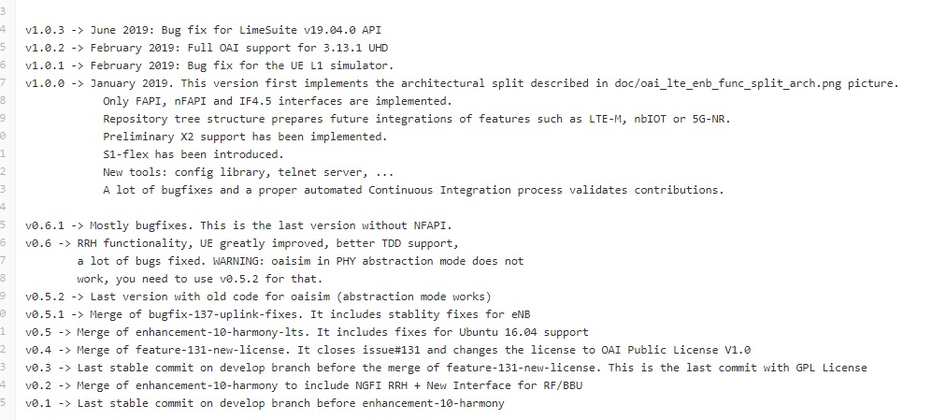
Version Decisions

Slide 9
Version Decisions

Slide 10
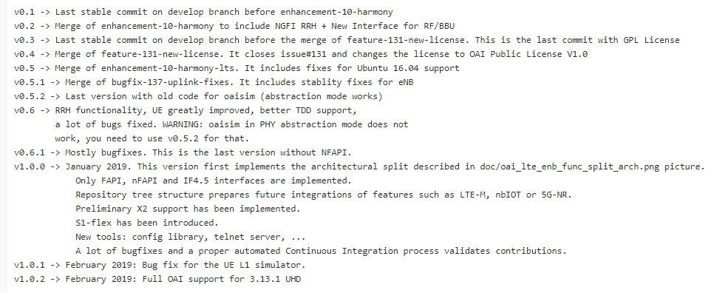
Version Decisions

Slide 11
Expected end product and Deliverables
As we complete this project, we are expected to provide our client with:
Demonstration and performance evaluation of existing OpenAirInterface simulation/emulation systems
Detailed design and implementation of the Physical Layer Abstraction
Operation of efficient device-to-device communication, as well as the use of the enhanced system for studying 5G wireless solutions

Slide 12
Project Plan
Important Tasks:
Task 1: Research 5G networking
Task 2: Install necessary software (Ubuntu and Virtualbox)
Task 3: Practice conducting simulations of the template and provided code in OpenAirInterface repository
Task 4: Document results

Slide 13
Project Plan - CONT.
Task 5: Isolate differences of version v0.5.2 and v1.0.2
Task 6: Using found differences and research done, implement the PHY abstraction layer
Task 7: Test speed of emulation and improve if needed
Task 8: Test for device-to-device communication

Slide 14
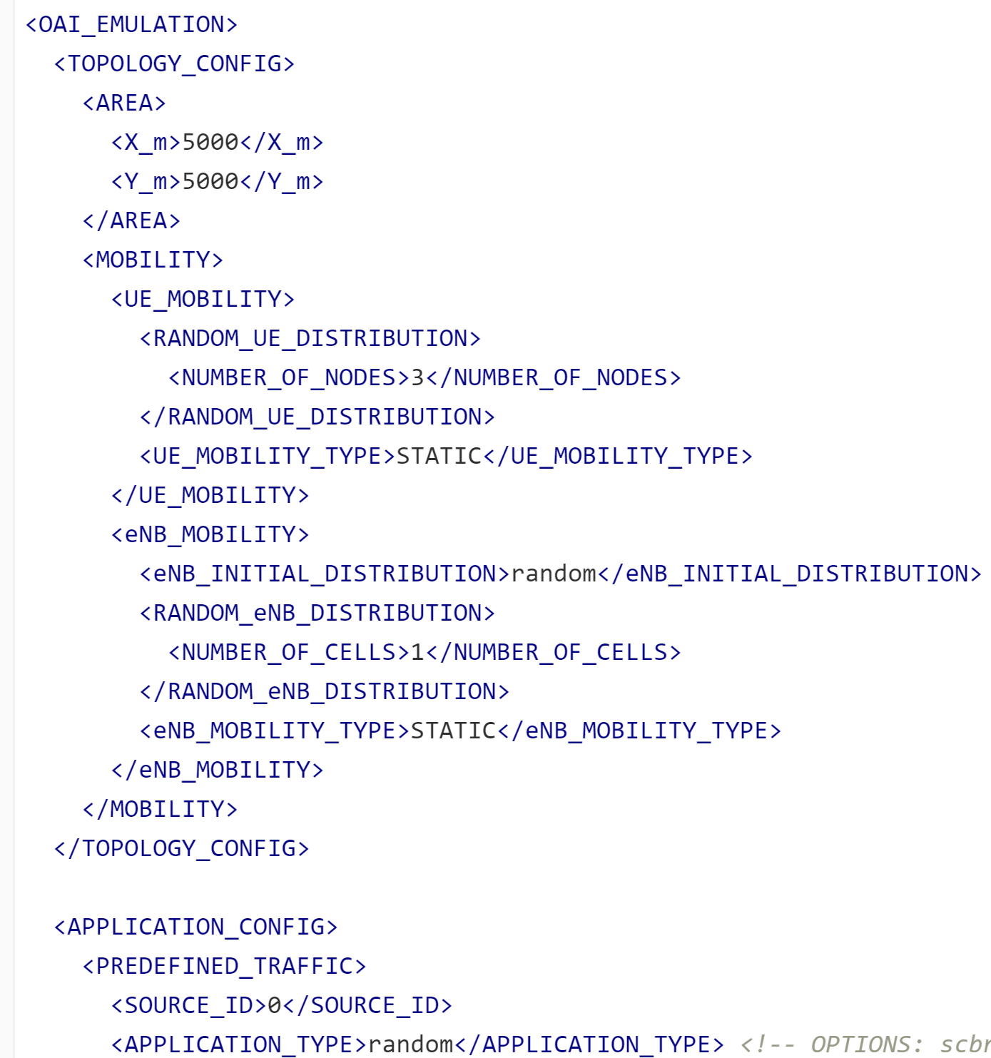
Test Plan
The test are performed through running a command and xml files(emulation)
Have to run a lot of different settings with test.
Try and emulate for longer periods of time.

Slide 15
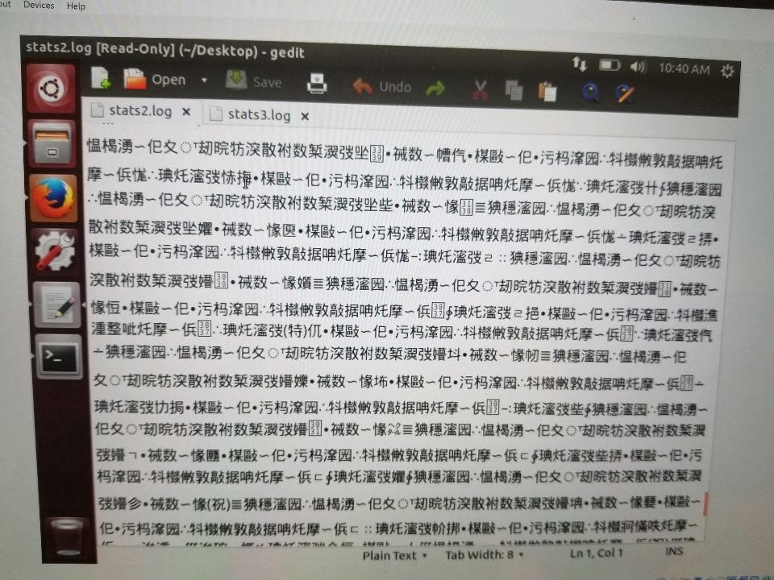
Technical challenges
Ubuntu Linux machine was missing required commands when initially when downloaded
Expected output from the simulations that was run displayed incorrect characters
Command line to run code wasn’t functioning properly due to revision of linux machine
Understanding of code needs to be assessed
Missing variables when attempting to run the simulation

Slide 16
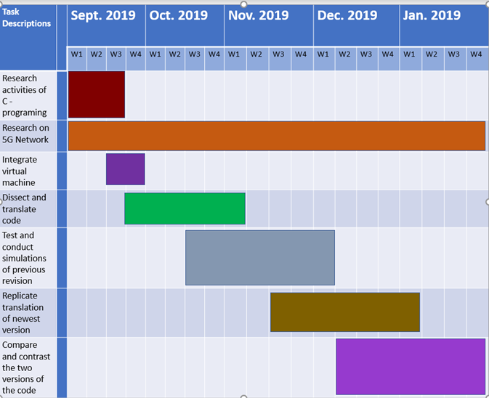
Timeline - Fall Semester Milestones

Slide 17
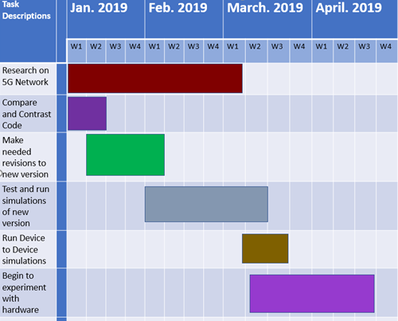
Timeline - Spring Semester Goals

Slide 18
Thank You!
Team 35:
Andrew Whitehead, Dazhawn Davis, Ousmane Ntutume, Nolan Cardona, Rohan Willis
Website: https://sdmay20-35.sd.ece.iastate.edu/
Advisor/Client: Hongwei Zhang, Mattias

